Slide 1

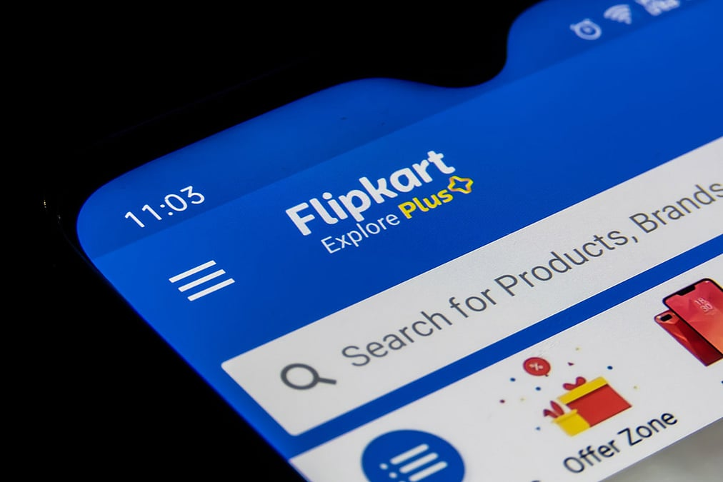
Title: Exploratory Data Analysis of Smartphone Pricing and Specifications on Flipkart

Slide 2
About Us:
I am R. Sai Sandeep, a B.Tech graduate passionate about Data Analytics and Data Visualization.
I enjoy exploring data-driven insights from real-world datasets and working on web data extraction, business trend analysis, and analytical dashboards.
LINKEDIN: https://www.linkedin.com/in/sandeep-ramadugula-23b250296/
GITHUB: mailto:https://github.com/Rsandeep07

Slide 3
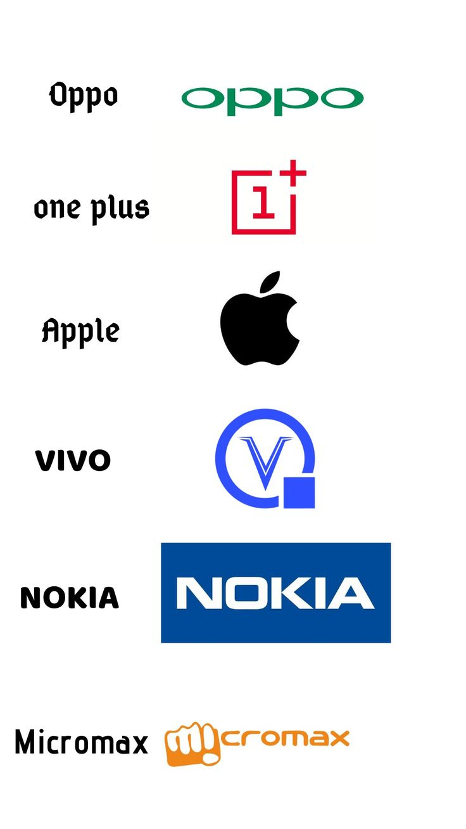
Introduction:
The smartphone market is highly competitive with frequent model launches across brands and price segments.
Product specifications on e-commerce platforms like Flipkart are scattered and unstructured.
This makes comparison and analysis of smartphone features difficult for consumers and analysts.
Web scarping helps in collecting real-time mobile data directly from Flipkart.
In this project, Python libraries Requests and BeautifulSoup were used to extract product details.
The scraped data was cleaned, processed, and converted into a structured dataset using Pandas.
The final dataset enables brand comparison, price analysis, feature distribution, and trend insights.

Slide 4

Business Problem:
Mobile phone data on Flipkart is spread across multiple product pages and is not directly structured
for analysis.
Specifications such as RAM, ROM, processor, and battery are not consistently formatted, which
makes comparison difficult.
Prices and ratings change frequently, making it challenging to track market trends accurately.
Multiple variants of the same model lead to confusion in evaluating value for money
.
A cleaned and organized dataset is required to support clear comparison and insight-driven decision making.

Slide 5
Objectives:
To extract mobile phone data such as price, RAM, ROM, battery and ratings from Flipkart.
To clean, organize and convert the raw scraped data into a structured dataset.
To analyze market trends across brands and model segments
To create visual insights that support comparison and understanding of market positioning.
.

Slide 6
Web Scraping:
Flipkart mobile pages were selected as the primary data source.
Python libraries Requests and BeautifulSoup were used for HTML parsing.
Product details were iterated and extracted across multiple pages for multiple brands.
Random delays were added to avoid request blocking.
Extracted values were stored in lists and converted to a dataframe

Slide 7






Tools Used:

Slide 8
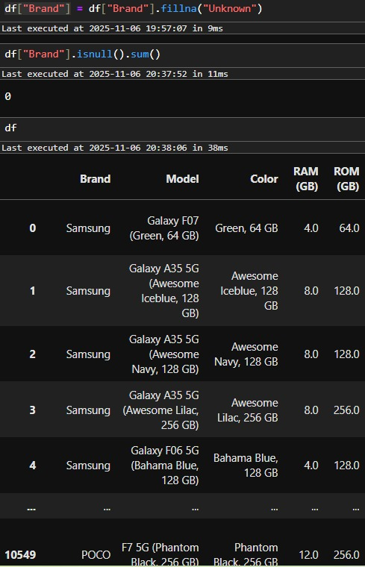
Data Cleaning Steps:
Removed extra characters and formatting from specifications.
Standardized text values for RAM, ROM, processor and battery capacity.
Converted price, rating and review counts into numeric values.
Handled missing values and removed duplicate entries.
Structured data into columns for easier analysis and visualization

Slide 9
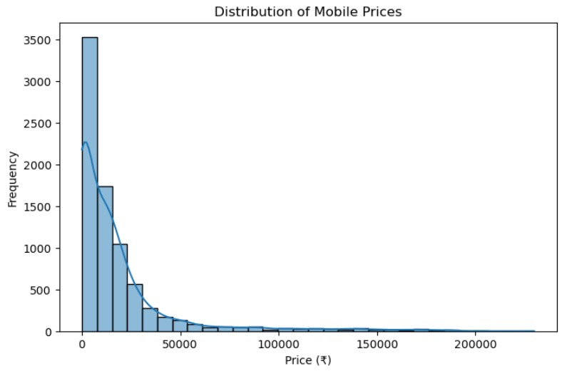
Data Visualization:
The distribution is highly right-skewed, indicating that most mobile phones are priced at the lower end of the spectrum.
The majority of mobiles are priced below ₹20,000, showing that budget and mid-range phones dominate the market.
There is a sharp drop in frequency as prices increase beyond ₹25,000, suggesting fewer high-end or premium devices.
Very few phones exceed ₹100,000, representing a niche luxury segment.
The peak frequency occurs in the lowest price range (around ₹5,000–₹10,000), reflecting strong affordability demand.
The distribution tail extends beyond ₹200,000, indicating that ultra-premium models exist but are rare.
Overall, the mobile price market is concentrated in the lower price bands, with a gradual decline toward higher prices.
BAR CHART

Slide 10
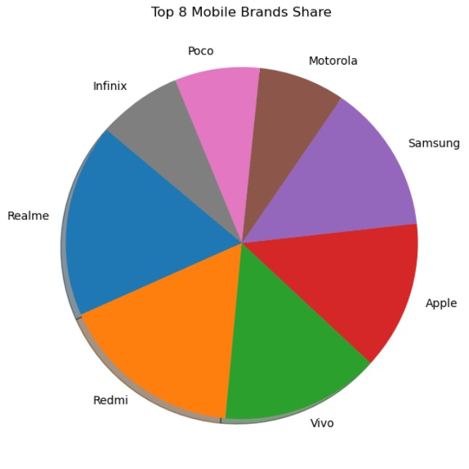
Data Visualization:
Vivo, Redmi, and Realme hold the largest market shares, dominating the mobile segment.
Apple and Samsung also have significant shares, reflecting their strong premium market presence.
Infinix, Poco, and Motorola capture smaller portions, representing the mid- to budget-range competition.
The market is competitive, with no single brand overwhelmingly dominating.
Vivo’s share appears slightly ahead, indicating strong consumer preference in the segment.
Redmi and Realme together make up a major portion of the affordable smartphone market.
The chart reflects a balanced distribution between premium and budget brands, showing wide consumer diversity.
PIE CHART

Slide 11
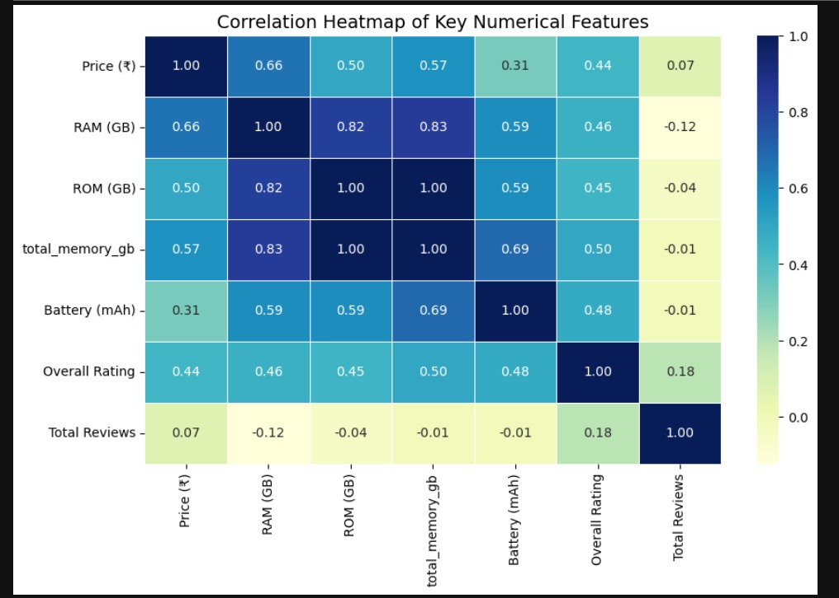
Data Visualization:
Price and RAM show a strong positive correlation (0.66) — higher RAM generally leads to higher prices.
RAM and ROM are highly correlated (0.82), indicating that phones with more RAM often come with higher storage.
Total memory has the strongest correlation with RAM (0.83), which is expected since it’s derived from memory components.
Battery capacity shows a moderate correlation with both RAM and ROM (≈0.59), suggesting higher-end phones often have larger batteries.
Overall Rating has a moderate positive correlation (≈0.45–0.50) with specs like RAM, ROM, and total memory.
Price and Total Reviews show a weak correlation (0.07) — price does not significantly impact the number of reviews.
Total Reviews have negligible correlation with other features, implying that popularity depends on more than just specifications.
HEAT MAP

Slide 12
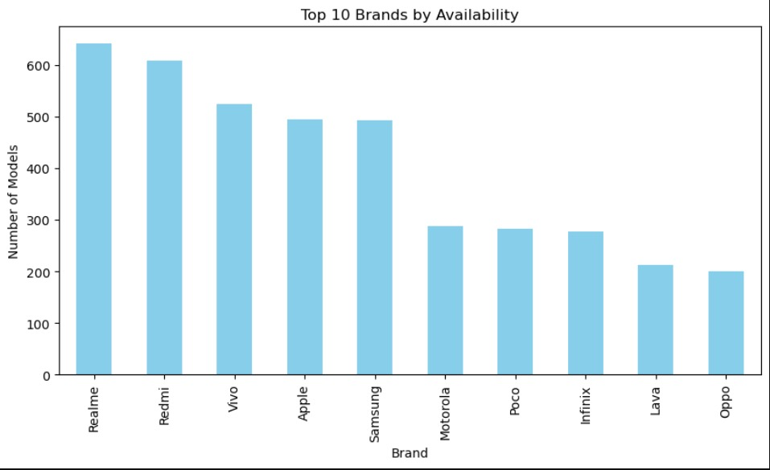
Data Visualization:
Realme leads the market — Realme has the highest number of available models, exceeding 650, showing strong product diversity.
Redmi follows closely — Redmi ranks second with over 600 models, indicating intense competition with Realme.
Vivo, Apple, and Samsung — These three brands form the mid-tier group, each offering between 490 and 530 models.
Balanced competition — The top five brands collectively dominate the market, highlighting customer preference for well-known names.
Motorola, Poco, and Infinix — These brands show moderate model availability (around 270–290), appealing to niche or budget-friendly segments.
Lava and Oppo at the bottom — With around 200–210 models, they have the smallest variety among the top 10.
BAR GRAPH

Slide 13
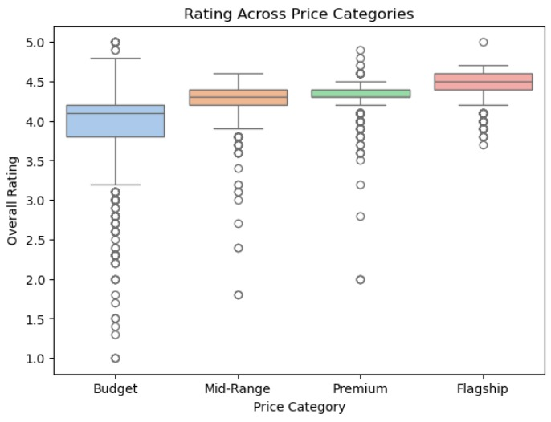
Data Visualization:
Overall trend: Average ratings generally increase with higher price categories.
Budget phones: Show the widest rating variation, ranging from very low to high scores.
Mid-Range phones: Have consistent ratings around 4.2–4.4, indicating balanced performance and value.
Premium segment: Displays slightly higher median ratings, showing better user satisfaction.
Flagship phones: Achieve the highest and most consistent ratings, with medians close to 4.5–4.6.
Outliers: Budget and mid-range categories have several low-rating outliers, showing inconsistent quality.
Conclusion: Higher-priced phones tend to deliver more consistent and higher user satisfaction.
BOX PLOT

Slide 14
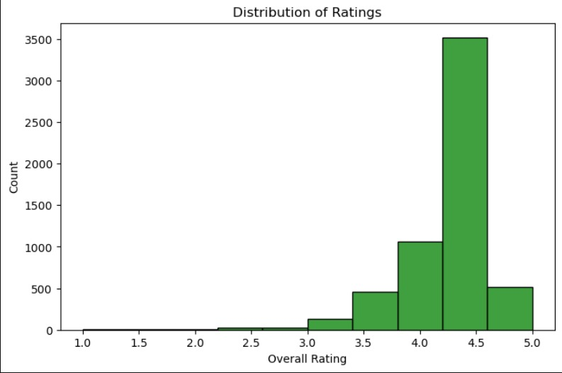
Data Visualization:
Ratings are highly positive — Most ratings fall between 4.0 and 4.5, showing strong customer satisfaction.
Peak around 4.4 — The highest concentration of ratings is near 4.4, indicating consistently high-quality products.
Few low ratings — Very few ratings are below 3.0, suggesting minimal dissatisfaction.
Right-skewed distribution — The histogram leans toward higher values, emphasizing generally favorable reviews.
Moderate count between 3.5–4.0 — A small number of average ratings suggest a middle-performing segment.
High volume of reviews — Over 3,500 products are rated in the 4.4 range, showing trust and popularity.
Conclusion: Overall customer perception is strongly positive across the dataset.
BAR CHART

Slide 15
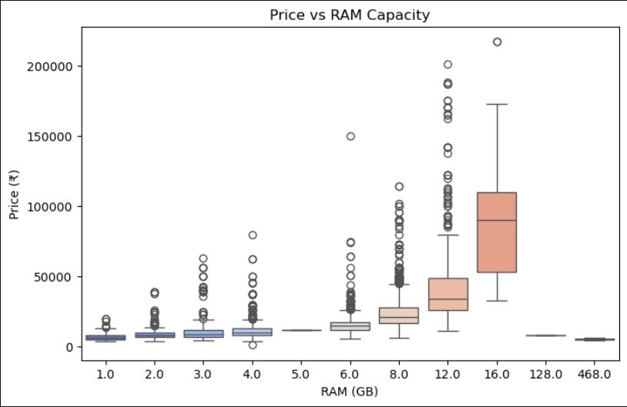
Data Visualization:
As RAM capacity increases, the price of devices also tends to rise.
Higher RAM models like 12GB and 16GB show a wider range of prices.
Several outliers are visible, indicating some premium or high-performance devices.
Devices with 1GB to 4GB RAM mostly fall under ₹20,000, showing they belong to the budget segment.
Models with 6GB to 8GB RAM are moderately priced, between ₹20,000 and ₹60,000.
Devices with 12GB and 16GB RAM are generally in the premium segment, exceeding ₹1,00,000.
Extremely high RAM values such as 128GB and 468GB are rare or may be data anomalies.
BOX PLOT

Slide 16
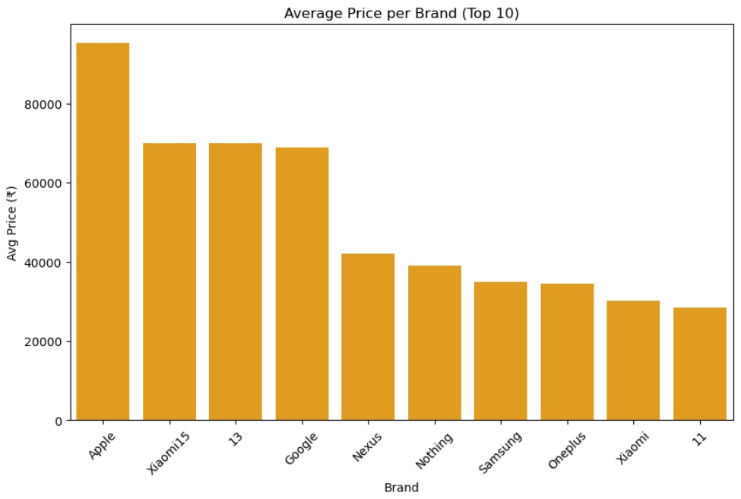
Data Visualization:
Apple holds the highest average price among all brands, exceeding ₹90,000.
Xiaomi15, 13, and Google follow with similar average prices around ₹70,000.
A noticeable price gap exists between Apple and other brands, highlighting Apple’s premium positioning.
Nexus and Nothing occupy the mid-range segment with average prices between ₹40,000–₹45,000.
Samsung and OnePlus offer slightly lower average prices, around ₹35,000–₹38,000.
Xiaomi and 11 have the lowest average prices among the top 10, around ₹30,000.
Overall, the chart shows a clear hierarchy of pricing — from luxury brands like Apple to budget-friendly ones like Xiaomi.
BAR GRAPH

Slide 17
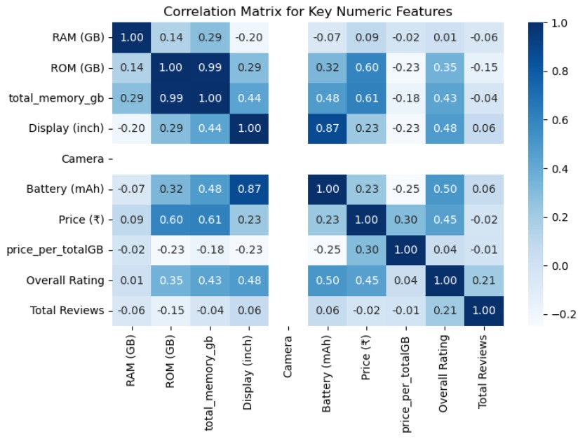
Data Visualization:
RAM and ROM show a weak positive correlation (0.14), indicating they vary somewhat independently.
ROM and total memory have a very strong positive correlation (0.99), as expected since total memory depends on ROM.
Display size and battery capacity are highly correlated (0.87), suggesting larger screens come with higher battery power.
Price shows a moderate positive correlation with ROM (0.60) and total memory (0.61), meaning higher memory devices tend to be costlier.
Overall rating has a weak to moderate correlation with display (0.48) and battery (0.50), implying better-rated phones often have larger displays and batteries.
The price per total GB metric has low or negative correlation with most features, indicating it varies independently of hardware specs.
HEAT MAP

Slide 18
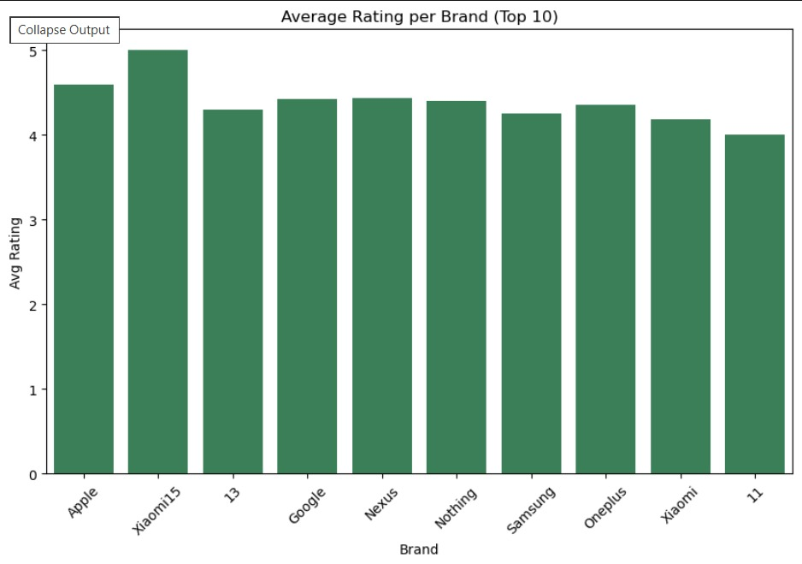
Data Visualization:
The chart compares average ratings of the top 10 smartphone brands on a scale from 0 to 5.
Xiaomi15 stands out with the highest average rating, slightly above 5, indicating exceptional user satisfaction.
The brand labeled "11" has the lowest rating, just below 4, suggesting potential issues in quality or performance.
Multiple entries like Xiaomi15, Xiaomi, and 13 hint at brand segmentation or inconsistent naming conventions.
Well-known brands such as Apple, Samsung, Google, and OnePlus maintain strong ratings around 4.5 to 5.
Nothing and Nexus also perform competitively, reflecting positive consumer perception.
These insights can guide strategic decisions in marketing, product development, and competitive benchmarking.
BAR GRAPH
.

Slide 19

Key Business Questions
What is the main objective of analyzing the Flipkart Phones Dataset?
Which Python libraries are primarily used for data scraping and analysis in this project?
What is the business problem addressed by this dataset?
Which of the following can be an analytical goal of this project?
Which feature is most useful to determine the value-for-money of a phone?
Which visualization would best show the relationship between price and rating?
What kind of insights can this project generate for business use?

Slide 20
Conclusion:
Consistent High Ratings and Brand Competition
Top smartphone brands on Flipkart show consistently high average ratings, with most scoring between 4 and 5—indicating strong consumer satisfaction and competitive product quality.
Brand Variants and Naming Overlap
Multiple entries like Xiaomi15, Xiaomi, and 13 suggest naming inconsistencies or variant overlap, which may affect clarity in brand perception and data interpretation.
Dominance of Flagship Models
Xiaomi15, Apple, and Samsung consistently rank among the highest-rated brands, reflecting their strong market presence and consumer trust across product lines.
Rating Spread Highlights Quality Gaps
While top brands maintain ratings above 4.5, lower-rated entries like "11" reveal gaps in performance or user experience, offering opportunities for improvement.
Consumer Feedback Drives Insights
Average ratings serve as a proxy for user satisfaction, helping identify strengths in design, performance, and value across brands.

Slide 21
Q&A

Slide 22
Experience– Web Scraping & Data Analysis:
Scraped smartphone data from Flipkart using Python (Beautiful Soup, Pandas).
• Cleaned and standardized key fields: price, brand, overall rating.
• Created visualizations for price categories and rating distribution.
• Completed an end-to-end data workflow:
    scraping → cleaning → analysis → visualization.

Slide 23
Challenges – Web Scraping & Data Analysis:
Inconsistent webpage structures across Brands.
Missing or mismatched match details.
Handling duplicate, noisy, and unclean data.
Dealing with request blocks and slow scraping speed.
Selecting the most meaningful visuals for insights..

Slide 24


